Slide 1

BMB5113 COMPUTER VISION
INTRODUCTION

Slide 2

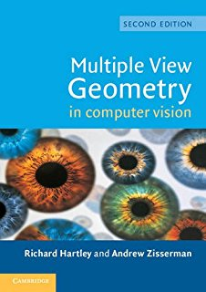
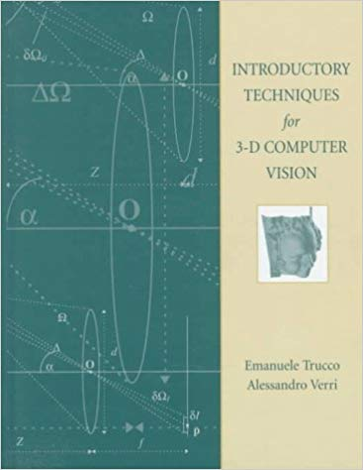
Resources
Books
Szeliski, R., 2010. Computer Vision: Algorithms and Applications, Springer.
Hartley, R., and Zisserman, A., 2003. Multiple View Geometry in Computer Vision, Cambridge University Press (2nd Edition).
Trucco, E., and Verri, A., 1998. Introductory Techniques for 3-D Computer Vision, Prentice Hall.

Slide 3
Resources (cont’d)
Lecture notes of computer vision courses
Princeton University
Washington University
Massachusetts Institute of Technology
Boğaziçi University
Yıldız Technical University
Other miscellaneous resources
Digital image processing resources
OpenCV and MATLAB tutorials
Papers

Slide 4
Information Sharing
Log in with «Öğrenci» option
https://ukey.uludag.edu.tr/Home

Slide 5
Assessment Criteria
5 small or medium-level homework 50%
1 take-home exam 20%
Term project 30%
Introductory report 10%
Introduction
Literature review (at least 3 related papers)
Methodology (Proposed )
Final presentation and report 20%
Methodology (Completed)
Experimental results
Conclusions

Slide 6
How to give the project class talk
Initial conditions:
I started with a great idea
It did not work
The day before the presentation I found 40 papers that already did this work
Then I also realized that the idea was not so great
How do I present?
Just give a good talk

Slide 7
Sources on Writing Technical Papers
How to Get Your SIGGRAPH Paper Rejected, Jim Kajiya, SIGGRAPH 1993 Papers Chair, https://www.siggraph.org/sites/default/files/kajiya.pdf
Informal guidelines for writing a paper,
Ted Adelson, 1991. http://www.ai.mit.edu/courses/6.899/papers/ted.htm
Notes on technical writing, Don Knuth, 1989.
http://www.ai.mit.edu/courses/6.899/papers/knuthAll.pdf

Slide 8
Tentative Course Schedule
Introduction to image processing
Image formation and color
Feature detection
Detectors and descriptors
Transformations and camera calibration
Stereo vision and photometric stereo
Image matching and 3D reconstruction
Background subtraction and keyframe detection
Optical flow and tracking
Shape and texture modelling
Registration
Segmentation
Recognition
Structure from motion
Project presentations

Slide 9
And now, who are you?
And what do you expect to get out of this class?
Previous experience in vision, learning, graphics?
Research agenda?
(Project topics?)

Slide 10
What is Computer Vision?
Automatic understanding of input images and video
Computing properties of the 3D world from visual data (measurement)
Algorithms and representations to allow a machine to recognize objects, people, scenes, and activities. (perception and interpretation)

Slide 11
What is Computer Vision?
Extract information about images
image
Computer Vision
info
image
Image Processing
image
info
Computer Graphics
image

Slide 12

What is Computer Graphics
Vision
Graphics
Inverse problems: analysis and synthesis.

Slide 13
What is Image Processing?
image
Image Processing
image
Image enhancement
Image restoration
Image filtering
Image compression

Slide 14
Why Computer Vision?
As image sources multiply, so do applications
Relieve humans of boring, easy tasks
Enhance human abilities: human-computer interaction, visualization
Perception for robotics / autonomous agents
Organize and give access to visual content

Slide 15
Who Cares?
Applications of computer vision
In AI: vision serves as the “input stage”
In robotics: localization, mapping, obstacle detection
In medicine: understanding and aiding human vision
In engineering: generating models of the world

Slide 16
Current State of the Art
Let’s see some examples of current systems.
Many of these are less than 5 to 10 years old
This is a very active research area, and rapidly changing
To learn more about vision applications and companies
David Lowe maintains an overview of vision companies
http://www.cs.ubc.ca/spider/lowe/vision.html
InfoDif (Ankara, Turkey). Vision systems for broad range of industries and applications.

Slide 17
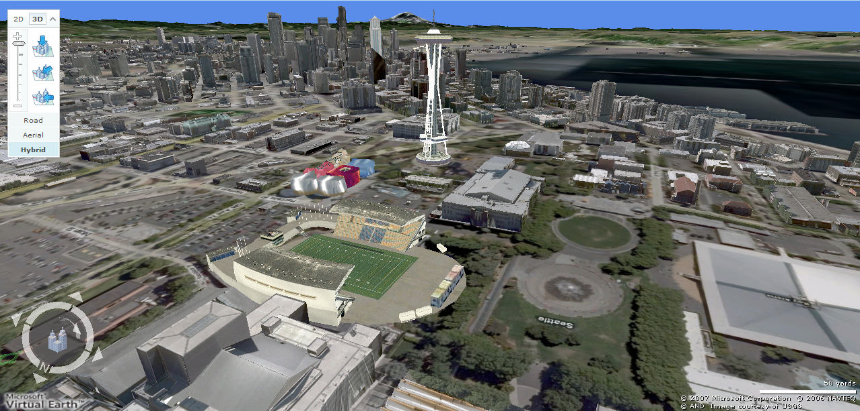
Earth viewers (3D modeling)
Image from Microsoft’s Virtual Earth
(see also: Google Earth)

Slide 18
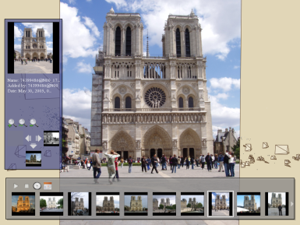
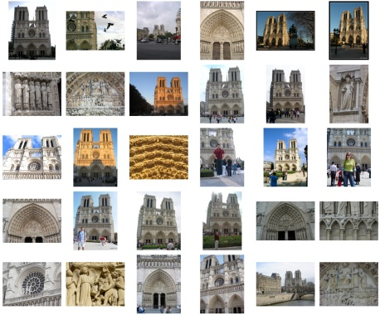
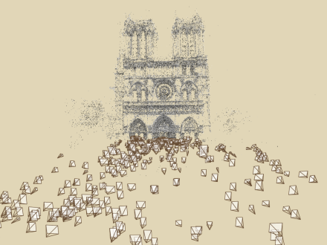
Photo Tourism overview
System for interactive browsing and exploring large collections of photos of a scene.
Computes viewpoint of each photo as well as a sparse 3d model of the scene.
Photo Explorer
Scene reconstruction
Input photographs
Relative camera positions and orientations
Point cloud
Sparse correspondence

Slide 19
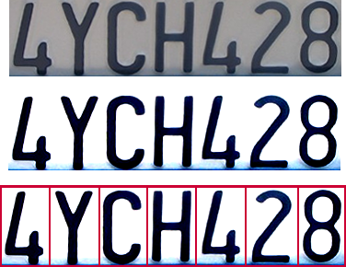

Optical character recognition (OCR)
Technology to convert scanned docs to text
If you have a scanner, it probably came with OCR software
Digit recognition, AT&T labs
http://www.research.att.com/~yann/
License plate readers
http://en.wikipedia.org/wiki/Automatic_number_plate_recognition

Slide 20
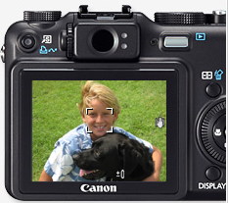
Face and smile detection?

Slide 21
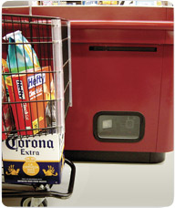
Object recognition
LaneHawk by EvolutionRobotics
“A smart camera is flush-mounted in the checkout lane, continuously watching for items. When an item is detected and recognized, the cashier verifies the quantity of items that were found under the basket, and continues to close the transaction. The item can remain under the basket, and with LaneHawk,you are assured to get paid for it… “

Slide 22
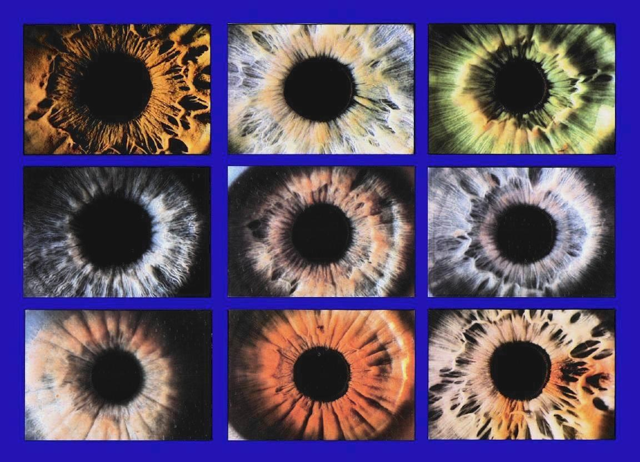
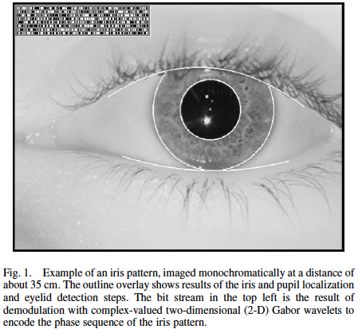
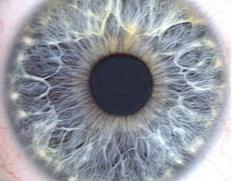
Vision-based biometrics
JOHN DAUGMAN

Slide 23
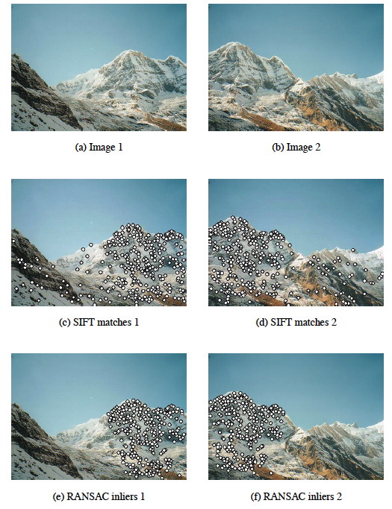
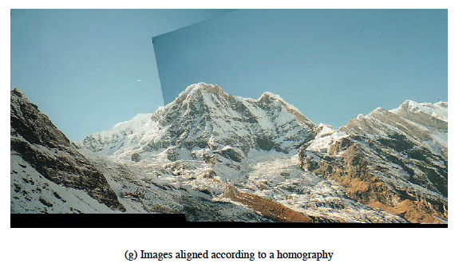
Image Stitching
Brown, Lowe, 2007

Slide 24
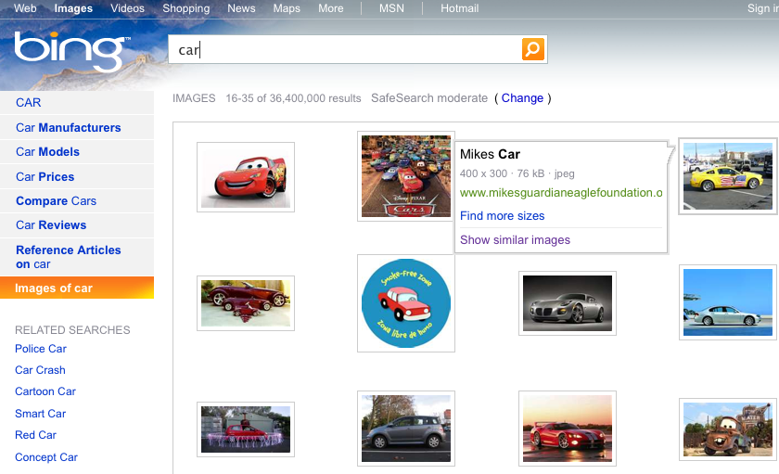
Content-based Image Retrieval

Slide 25
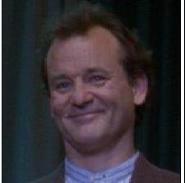

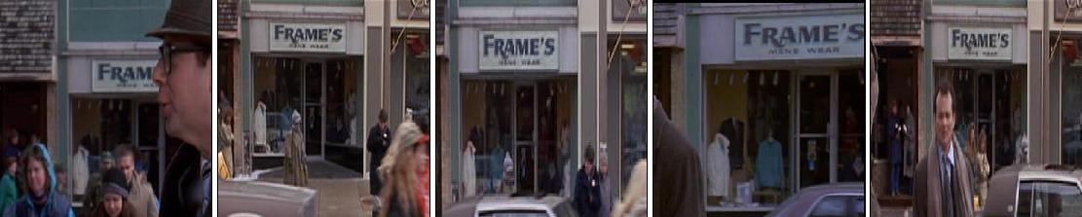
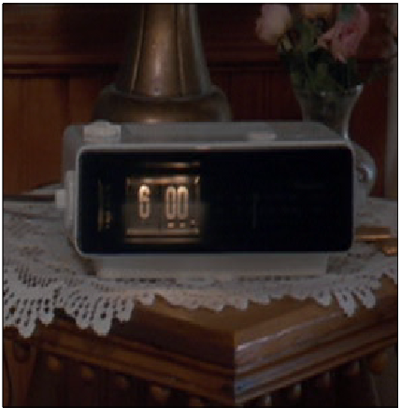
Visually defined search
Given an object specified by its image, retrieve all shots containing the object:

Slide 26
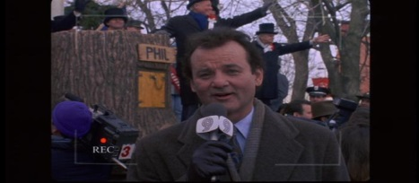
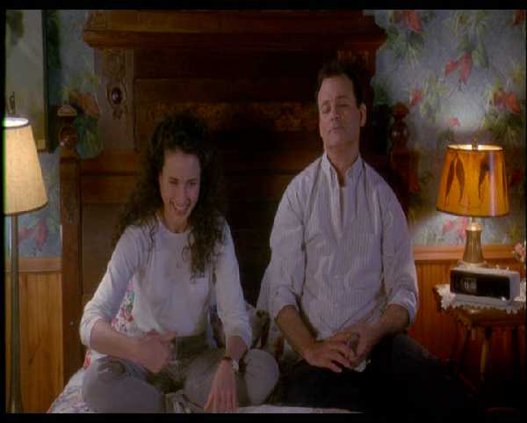
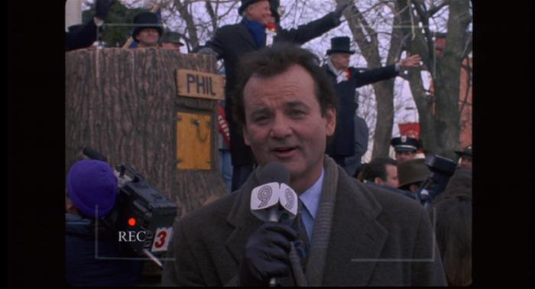
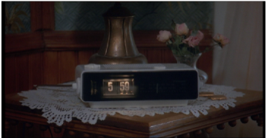
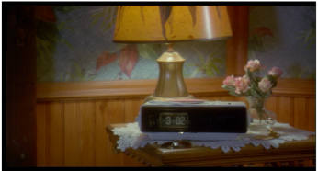
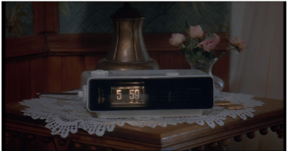


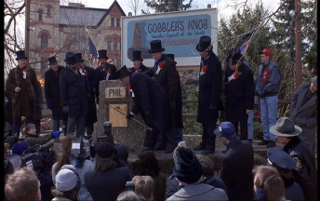


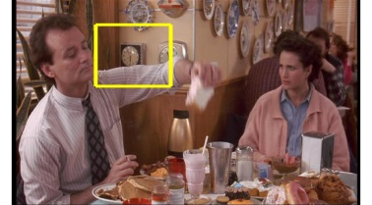
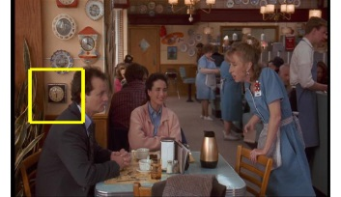

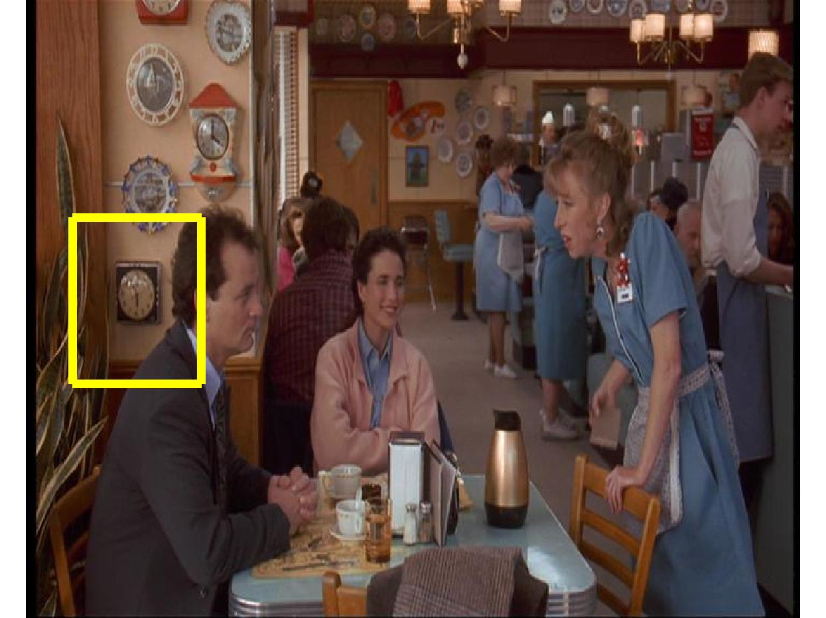
Visually defined search
must be efficient at run time and must handle:
scale changes
lighting changes
viewpoint changes
partial occlusion

Slide 27
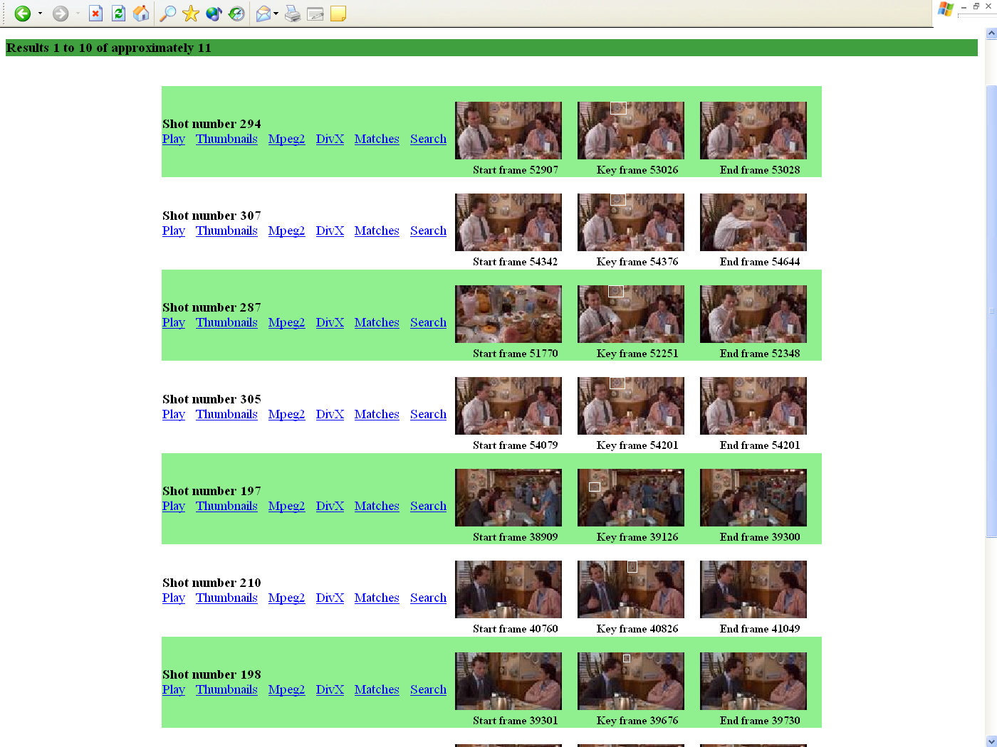
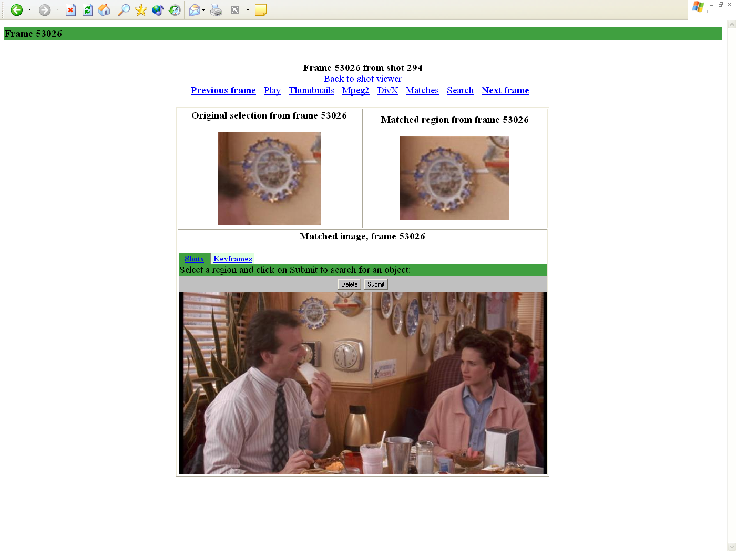
Video Summarization
Key frames

Slide 28
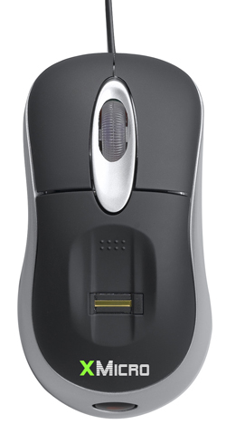

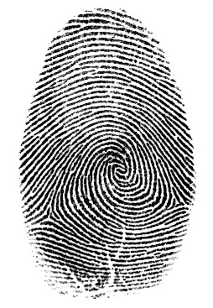

Login without a password…
Fingerprint scanners on many new laptops, other devices
Face recognition systems now beginning to appear more widely http://www.sensiblevision.com/

Slide 29
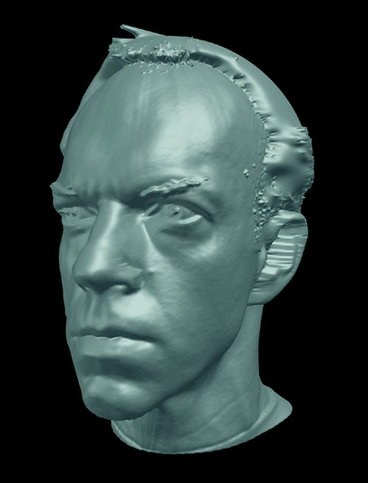
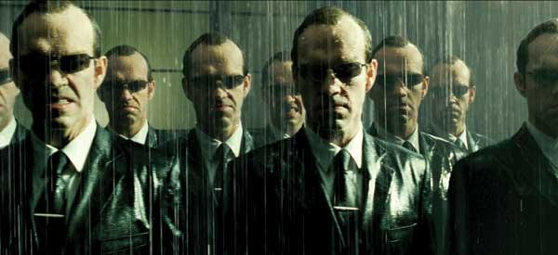
Special effects: shape and motion capture
The Matrix movies, ESC Entertainment, XYZRGB, NRC

Slide 30
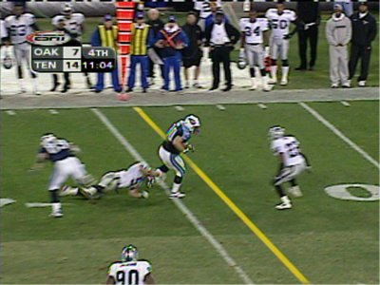
Sports
Sportvision first down line

Slide 31
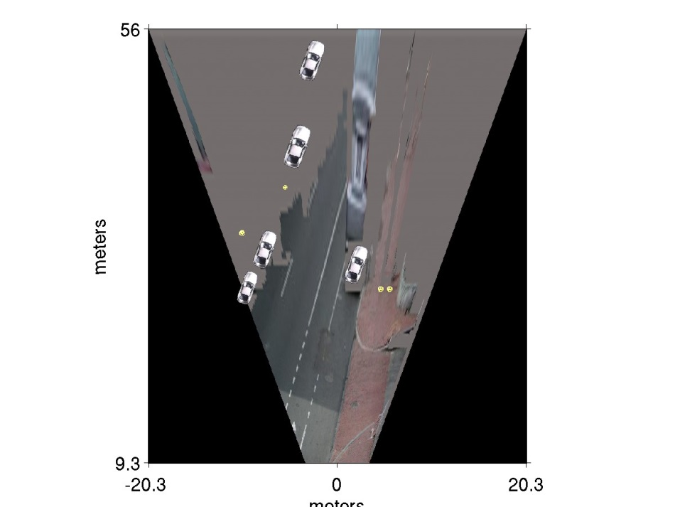
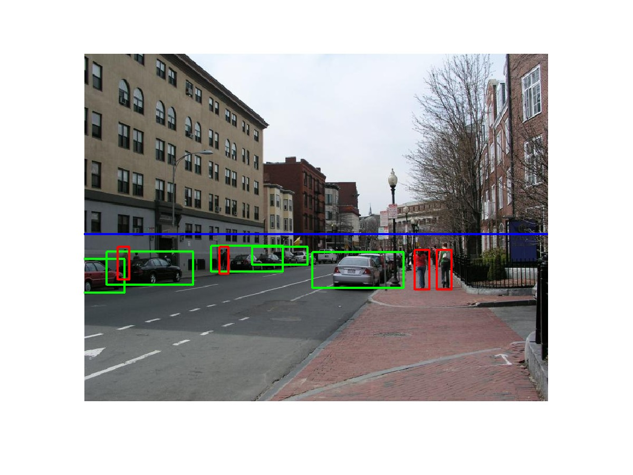
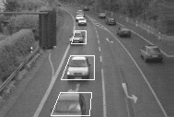
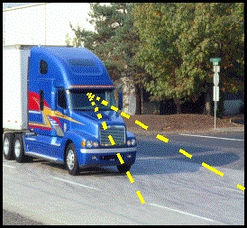
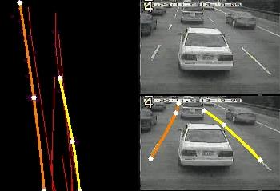
Smart cars
Pedestrian and car detection
meters
Ped
Ped
Car
meters
Lane detection
Collision warning systems with adaptive cruise control,
Lane departure warning systems,
Rear object detection systems,
Notes:
Mobileye
Vision systems currently in high-end BMW, GM, Volvo models
By 2010: 70% of car manufacturers.

Slide 32
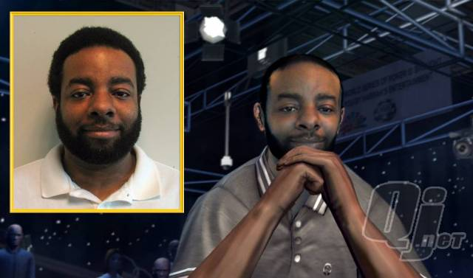
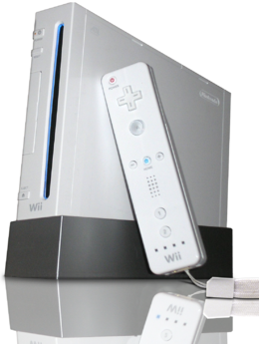
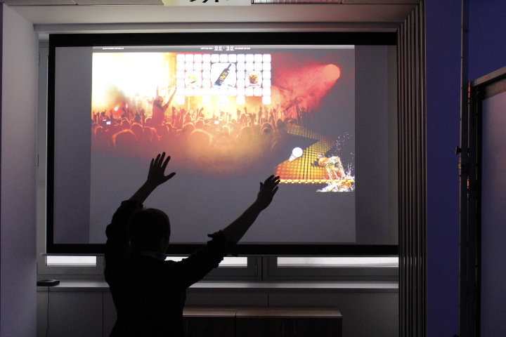
Vision-based interaction (and games)
Digimask: put your face on a 3D avatar.
Nintendo Wii has camera-based IR tracking built in.
“Game turns moviegoers into Human Joysticks”,

Slide 33
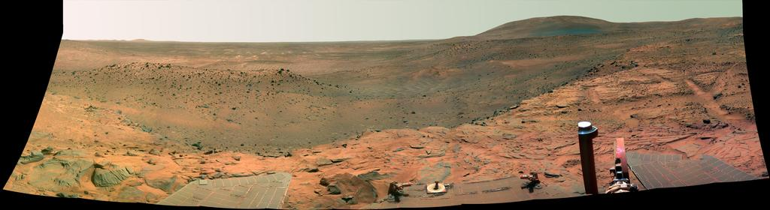
Vision in space
NASA'S Mars Exploration Rover Spirit captured this westward view from atop a low plateau where Spirit spent the closing months of 2007.
Vision systems (JPL) used for several tasks
Panorama stitching
3D terrain modeling
Obstacle detection, position tracking
For more, read “Computer Vision on Mars” by Matthies et al.

Slide 34

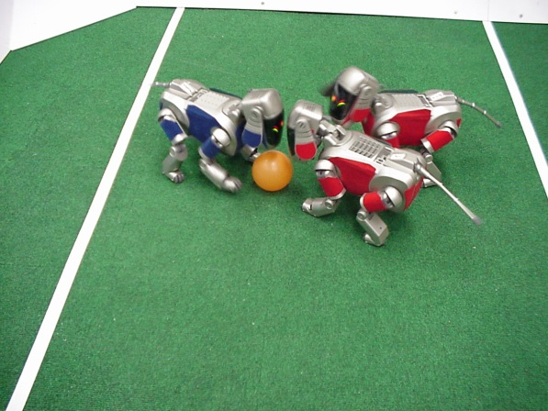
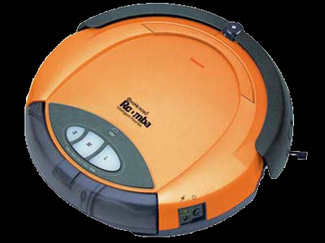
Robotics
http://www.robocup.org/
NASA’s Mars Spirit Rover
http://en.wikipedia.org/wiki/Spirit_rover
Roomba Vacuum Cleaner

Slide 35
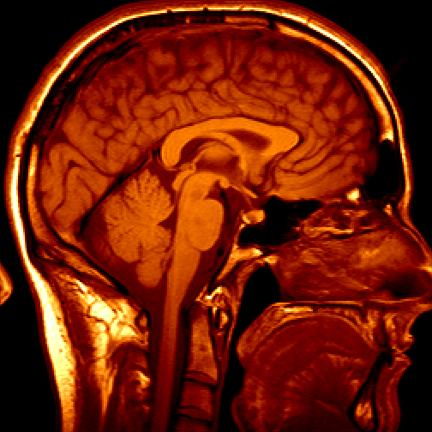
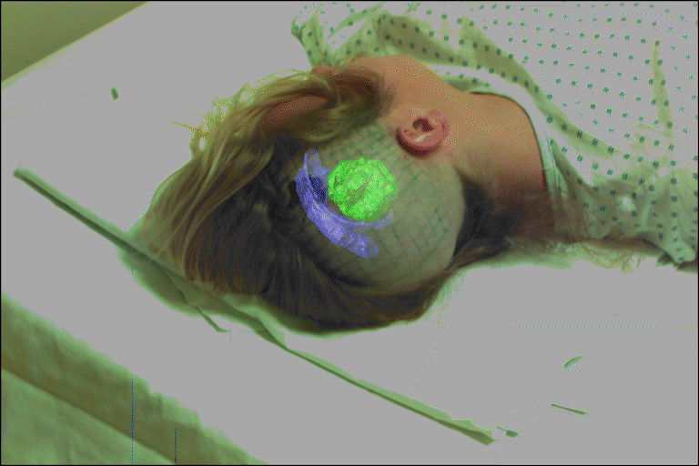
Medical imaging
3D imaging
MRI, CT
Image guided surgery
Grimson et al., MIT

Slide 36
Vision and Other Fields
Computer Vision
Cognitive Psychology
Computer Graphics
Machine Learning
Signal Processing
Pattern Analysis
Artificial Intelligence
Image Processing

Slide 37
Typical Computer Vision System
boundaries
regions
feature
vector
img
img
class
Feature
Extraction
Preprocessing
Segmentation
Classification
Preprocessing: Filtering, Enhancement
Segmentation: images in, boundaries and regions out
Feature extraction: images in; patterns out
Classification: Classify into one of predetermined classes

Slide 38
Does It Work?
Situation much the same as AI:
Some fundamental algorithms
Large collection of hacks / heuristics
Continuous progress: more success than you might think!
Vision is hard!
Especially at high level, physiology unknown
Requires integrating many different methods
Requires reasoning and understanding:
“AI completeness”

Slide 39
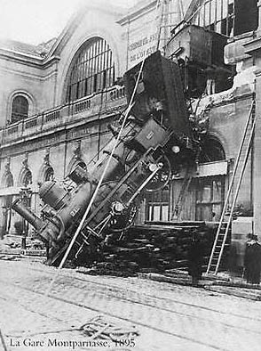
Why vision is hard?
Can computers match (or beat)
human vision?
Yes and no (but mostly no!)
humans are much better at “hard” things
computers can be better at “easy” things

Slide 40
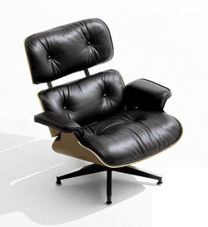





Why vision is hard?
Some things have strong variations in appearance

Slide 41

Why vision is hard?
Assumptions can be wrong

Slide 42

Why vision is hard?

Slide 43
Computer and Human Vision
Emulating effects of human vision
Understanding physiology of human vision
Analogues of human vision at low, mid, and high levels

Slide 44


Image Formation
Human: lens forms image on retina, sensors (rods and cones) respond to light
Computer: lens system forms image, sensors (CCD, CMOS) respond to light

Slide 45

Low-Level or “Early” Vision
Considers local properties of an image
“There’s an edge!”

Slide 46

Mid-Level Vision
Grouping and segmentation
“There’s an object and a background!”

Slide 47

High-Level Vision
Recognition
Classification
“It’s a chair! It’s in a room!”

Slide 48

Low-Level Vision
Primary Visual Cortex
Simple cells: orientational sensitivity
Complex cells: directional sensitivity
Further processing
Temporal cortex:
what is the object?
Parietal cortex:
where is the object?
how do I get it?
Hubel

Slide 49

Low-Level Vision
Net effect: low-level human vision can be (partially) modeled as a set of
multiresolution and oriented filters

Slide 50
Low-Level Computer Vision
Filters and filter banks
Implemented via convolution
Detection of edges, corners, and other local features
Can include multiple orientations
Can include multiple scales: “filter pyramids”
Applications
First stage of segmentation
Texture recognition / classification
Texture synthesis

Slide 51



Texture Analysis / Synthesis
Image
Image pyramid
Multiresolution oriented filter bank

Slide 52


Texture Analysis / Synthesis
Original Texture
Synthesized texture
[Heeger and Bergen]

Slide 53
Low-Level Computer Vision
Optical flow
Detecting frame-to-frame motion
Local operator: gradients over space and time
Applications
First stage of tracking

Slide 54



Optical Flow
Image 1
Optical flow field
Image 2

Slide 55
Low-Level Computer Vision
Shape from …
Stereo
Motion
Shading
Texture foreshortening

Slide 56




3-D Reconstruction
Tomasi+Kanade
Phigin et al.

Slide 57
Mid-Level Vision
Physiology unclear, but recent experiments with FMRI relate the following
Proximity
Similarity
Common fate
Common region
Parallelism
Closure
Symmetry
Continuity
Familiar configuration

Slide 58


Grouping Cues

Slide 59
Mid-Level Computer Vision
Techniques
Clustering based on similarity
Limited work on other principles
Applications
Segmentation / grouping
Tracking

Slide 60





Snakes: Active Contours
Contour Evolution for segmenting an artery

Slide 61

Histograms

Slide 62

Expectation Maximization (EM)
Color segmentation

Slide 63
Bayesian Methods
Prior probability
Expected distribution of models
Conditional probability P(A|B)
Probability of observation A given model B
Bayes’s Rule P(B|A) = P(A|B) ⋅P(B) / P(A)
Probability of model B given observation A

Slide 64




Bayesian Methods

Slide 65
High-Level Vision
Human mechanisms: ???
Computational mechanisms
Bayesian networks
Templates
Linear subspace methods
Kinematic models

Slide 66

Template-Based Methods
Cootes et al.

Slide 67

Linear Subspaces

Slide 68


Principal Components Analysis (PCA)
Data
New basis vectors
PCA

Slide 69




Kinematic Models
Optical Flow/Feature tracking: no constraints
Layered Motion: rigid constraints
Articulated: kinematic chain constraints
Nonrigid: implicit /learned constraints

Slide 70
Homework
Consider on your project suggestion
Set up Matlab and/or build OpenCV on your operating system

